Slide 1
Trigonometric Ratios and Functions
Algebra 2
Chapter 13
Notes:
Algebra II 13

Slide 2
This Slideshow was developed to accompany the textbook
  Larson Algebra 2
  By Larson, R., Boswell, L., Kanold, T. D., & Stiff, L.
  2011 Holt McDougal
Some examples and diagrams are taken from the textbook.
Slides created by
Richard Wright, Andrews Academy
rwright@andrews.edu

Slide 3
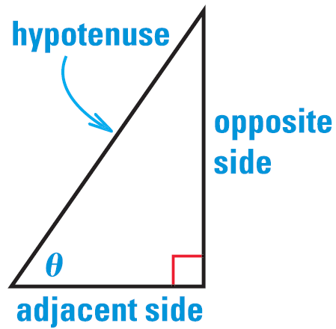
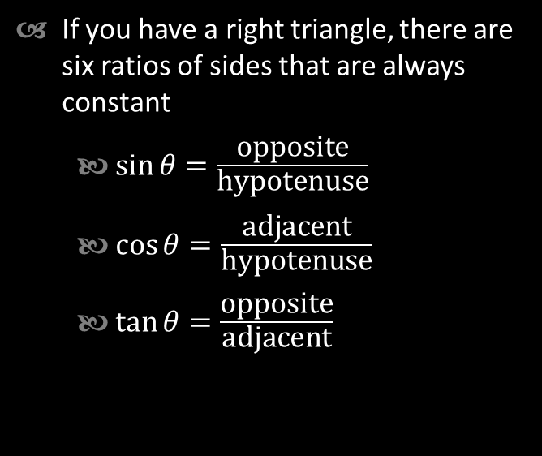

13.1 Use Trigonometry with Right Triangles
If you have a right triangle, there are six ratios of sides that are always constant
  $\sin{θ}=\frac{\text{opposite}}{\text{hypotenuse}}$
  $\cos{θ}=\frac{\text{adjacent}}{\text{hypotenuse}}$
  $\tan{θ}=\frac{\text{opposite}}{\text{adjacent}}$
  $\csc{θ}=\frac{\text{hypotenuse}}{\text{opposite}}$
  $\sec{θ}=\frac{\text{hypotenuse}}{\text{adjacent}}$
  $\cot{θ}=\frac{\text{adjacent}}{\text{opposite}}$
SOH
CAH
TOA

Slide 4
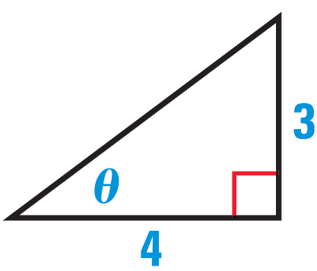

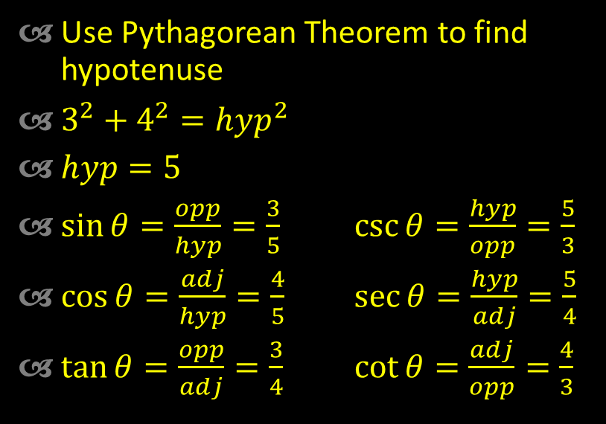
13.1 Use Trigonometry with Right Triangles
Evaluate the six trigonometric functions of the angle $θ$.
Use Pythagorean Theorem to find hypotenuse
$3^{2}+4^{2}=hyp^{2}$
$hyp=5$
$\sin{θ}=\frac{opp}{hyp}=\frac{3}{5}$ $\csc{θ}=\frac{hyp}{opp}=\frac{5}{3}$
$\cos{θ}=\frac{adj}{hyp}=\frac{4}{5}$ $\sec{θ}=\frac{hyp}{adj}=\frac{5}{4}$
$\tan{θ}=\frac{opp}{adj}=\frac{3}{4}$ $\cot{θ}=\frac{adj}{opp}=\frac{4}{3}$
Notes:
Use Pythagorean Theorem to find hypotenuse
$$3^{2}+4^{2}=hyp^{2}$$
$$hyp=5$$
$\sin{θ}=\frac{3}{5}$ $\cos{θ}=\frac{4}{5}$ $\tan{θ}=\frac{3}{4}$
$\csc{θ}=\frac{5}{3}$ $\sec{θ}=\frac{5}{4}$ $\cot{θ}=\frac{4}{3}$

Slide 5
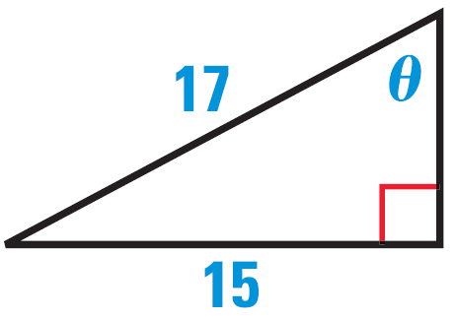


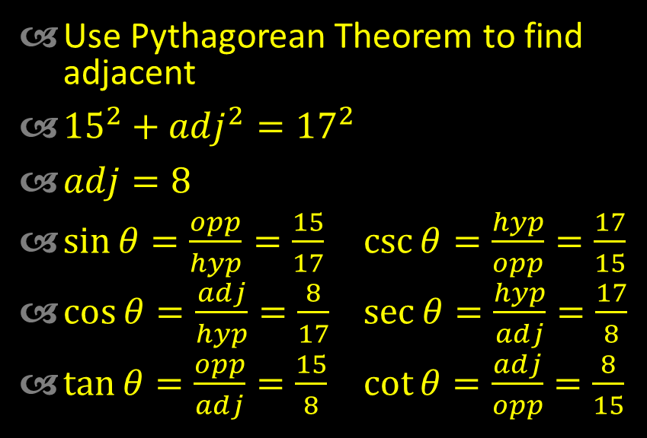
13.1 Use Trigonometry with Right Triangles
Evaluate the six trigonometric functions of the angle $θ$.
Use Pythagorean Theorem to find adjacent
${15}^{2}+adj^{2}={17}^{2}$
$adj=8$
$\sin{θ}=\frac{opp}{hyp}=\frac{15}{17}$ $\csc{θ}=\frac{hyp}{opp}=\frac{17}{15}$
$\cos{θ}=\frac{adj}{hyp}=\frac{8}{17}$ $\sec{θ}=\frac{hyp}{adj}=\frac{17}{8}$
$\tan{θ}=\frac{opp}{adj}=\frac{15}{8}$ $\cot{θ}=\frac{adj}{opp}=\frac{8}{15}$
Notes:
Use Pythagorean Theorem to find adjacent
$${15}^{2}+adj^{2}={17}^{2}$$
$$225+adj^{2}=289$$
$$adj^{2}=64$$
$$adj=8$$
$\sin{θ}=\frac{15}{17}$ $\cos{θ}=\frac{8}{17}$ $\tan{θ}=\frac{15}{8}$
$\csc{θ}=\frac{17}{15}$ $\sec{θ}=\frac{17}{8}$ $\cot{θ}=\frac{8}{15}$

Slide 6
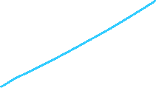
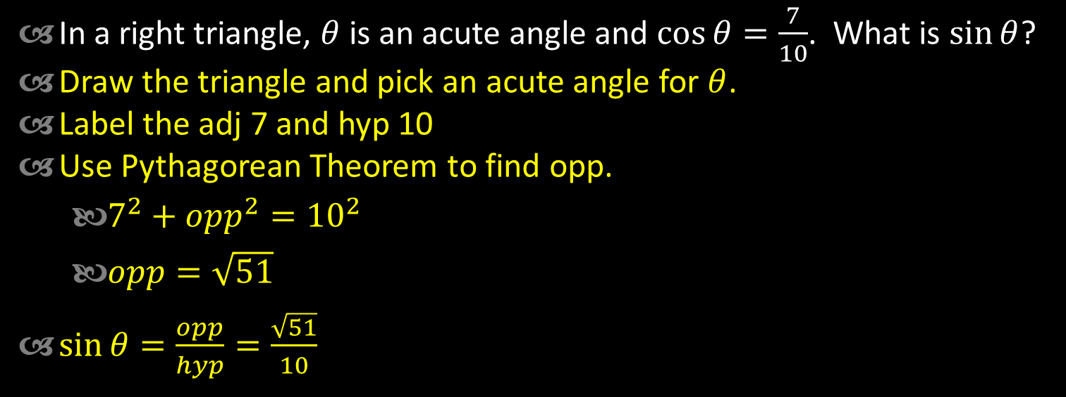

13.1 Use Trigonometry with Right Triangles
In a right triangle, $θ$ is an acute angle and $\cos{θ}=\frac{7}{10}$. What is $\sin{θ}$?
Draw the triangle and pick an acute angle for $θ$.
Label the adj 7 and hyp 10
Use Pythagorean Theorem to find opp.
  $7^{2}+opp^{2}={10}^{2}$
  $opp=\sqrt{51}$
$\sin{θ}=\frac{opp}{hyp}=\frac{\sqrt{51}}{10}$

Slide 7
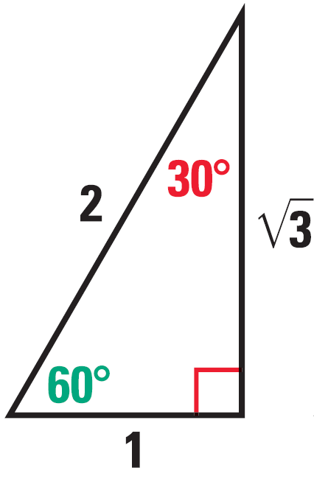
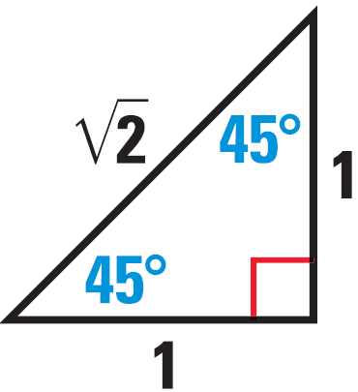
13.1 Use Trigonometry with Right Triangles
Special Right Triangles
30° - 60° - 90°
45° - 45° - 90°
Notes:
These triangles can be used to find sin, cos, tan of 30, 60, and 45 degree angles exactly.

Slide 8
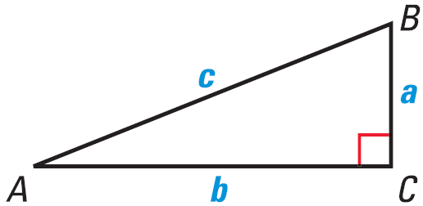
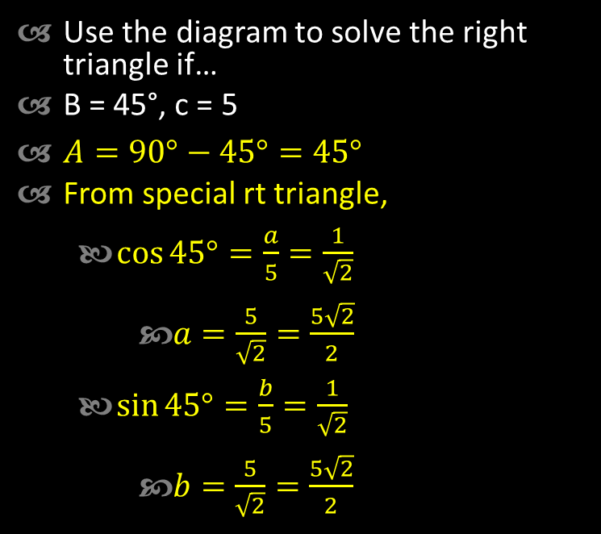

13.1 Use Trigonometry with Right Triangles
Use the diagram to solve the right triangle if…
B = 45°, c = 5
$A=90°−45°=45°$
From special rt triangle,
  $\cos{45°}=\frac{a}{5}=\frac{1}{\sqrt{2}}$
    $a=\frac{5}{\sqrt{2}}=\frac{5\sqrt{2}}{2}$
  $\sin{45°}=\frac{b}{5}=\frac{1}{\sqrt{2}}$
    $b=\frac{5}{\sqrt{2}}=\frac{5\sqrt{2}}{2}$
Notes:
A = 90° - 45° = 45°
From special rt triangle, $\sin{45°}=\frac{a}{5}=\frac{1}{\sqrt{2}}→$ $a=\frac{5}{\sqrt{2}}=\frac{5\sqrt{2}}{2}$
$\cos{45°}=\frac{b}{5}=\frac{1}{\sqrt{2}} →$ $b=\frac{5\sqrt{2}}{2}$

Slide 9
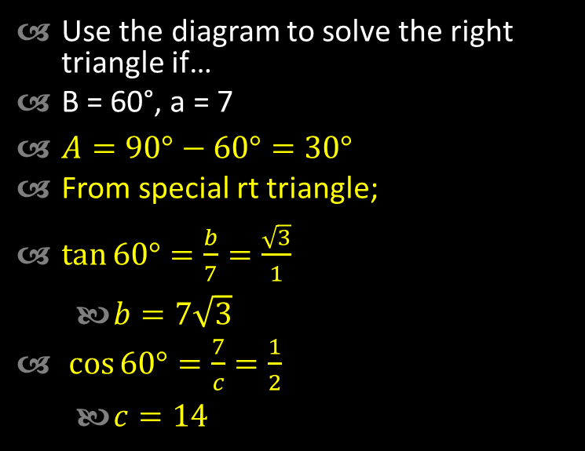

13.1 Use Trigonometry with Right Triangles
Use the diagram to solve the right triangle if…
B = 60°, a = 7
$A=90°−60°=30°$
From special rt triangle;
$\tan{60°=\frac{b}{7}}=\frac{\sqrt{3}}{1}$
  $b=7\sqrt{3}$
$\cos{60°}=\frac{7}{c}=\frac{1}{2}$
  $c=14$
Notes:
A = 90° - 60° = 30°
From special rt triangle; $\tan{60°=\frac{b}{7}}=\frac{\sqrt{3}}{1}→b=7\sqrt{3}$
$\cos{60°}=\frac{7}{c}=\frac{1}{2}→c=14$

Slide 10
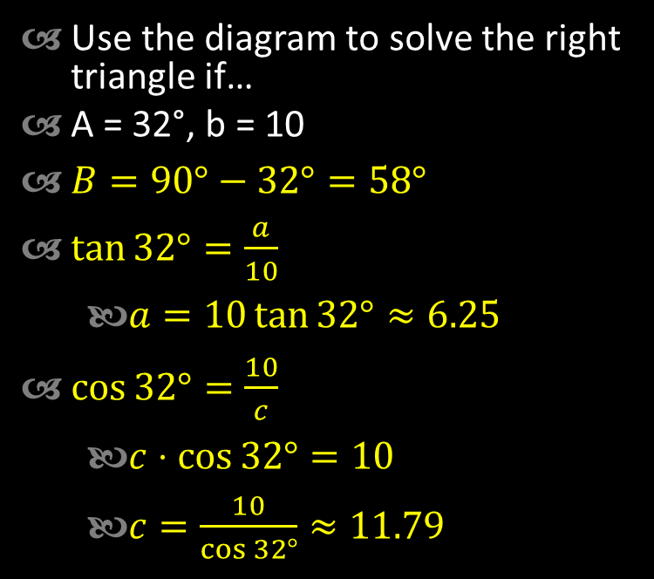
13.1 Use Trigonometry with Right Triangles
Use the diagram to solve the right triangle if…
A = 32°, b = 10
$B=90°−32°=58°$
$\tan{32°}=\frac{a}{10}$
  $a=10\tan{32°}≈6.25$
$\cos{32°}=\frac{10}{c}$
  $c⋅\cos{32°}=10$
  $c=\frac{10}{\cos{32°}}≈11.79$
Notes:
B = 90° - 32° = 58°
$\tan{32°}=\frac{a}{10}→a=10\tan{32°}≈6.25$
$\cos{32°}=\frac{10}{c}→c⋅\cos{32°}=10→c=\frac{10}{\cos{32°}}≈11.79$

Slide 11
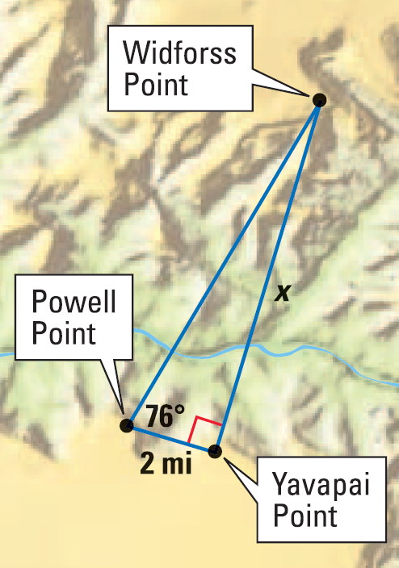

13.1 Use Trigonometry with Right Triangles
Find the distance between Powell Point and Widforss Point.
$\cos{76°}=\frac{2 \text{mi}}{y}$
$y⋅\cos{76°}=2 \text{mi}$
$y=\frac{2 \text{mi}}{\cos{76°}}≈8.27 \text{mi}$
Notes:
$$\cos{76°}=\frac{2 \text{mi}}{y}$$
$$y⋅\cos{76°}=2 \text{mi}$$
$$y=\frac{2 \text{mi}}{\cos{76°}}≈8.27 \text{mi}$$

Slide 12
Quiz
13.1 Homework Quiz

Slide 13
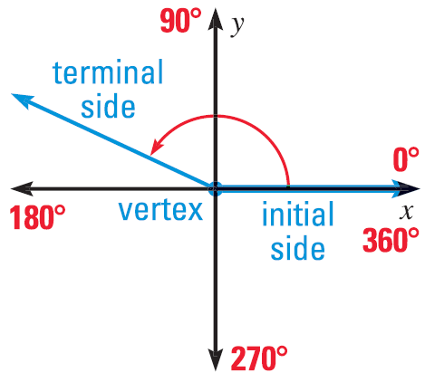
13.2 Define General Angles and Use Radian Measure
Angles in Standard Position
  Vertex on origin
  Initial Side on positive x-axis
  Measured counterclockwise

Slide 14
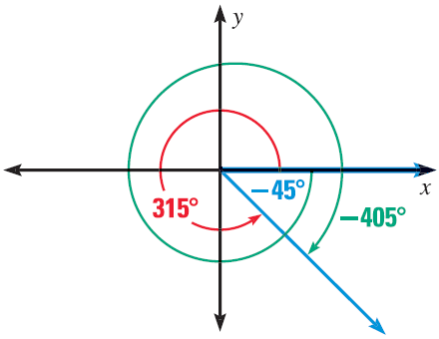
13.2 Define General Angles and Use Radian Measure
Coterminal Angles
  Different angles (measures) that have the same terminal side
  Found by adding or subtracting multiples of 360°

Slide 15
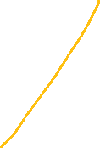


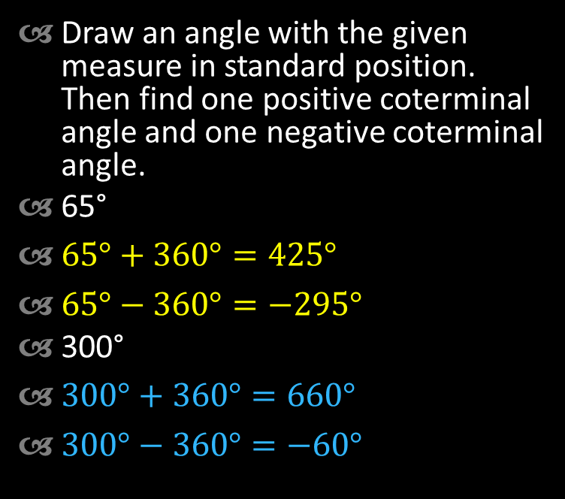
13.2 Define General Angles and Use Radian Measure
Draw an angle with the given measure in standard position. Then find one positive coterminal angle and one negative coterminal angle.
65°
$65°+360°=425°$
$65°−360°=−295°$
300°
$300°+360°=660°$
$300°−360°=−60°$
Notes:
65°+360°=425°; 65°-360°=-295°
300°+360°=660°; 300°-360°=-60°

Slide 16
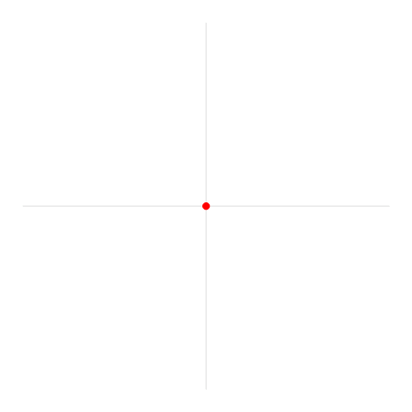
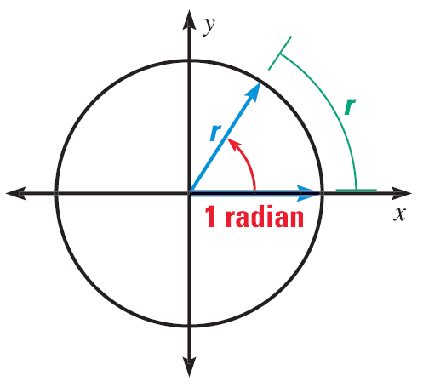
13.2 Define General Angles and Use Radian Measure
Radian measure
  Another unit to measure angles
  1 radian is the angle when the arc length = the radius
  There are 2π radians in a circle

Slide 17
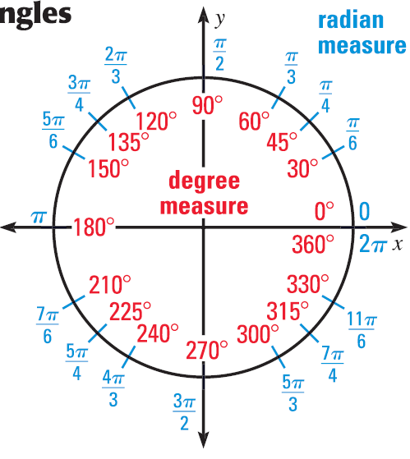
13.2 Define General Angles and Use Radian Measure
To convert between degrees and radians use fact that
  180° = π
Special angles
Notes:
Probably only need to memorize 1st quadrant

Slide 18


13.2 Define General Angles and Use Radian Measure
Convert the degree measure to radians, or the radian measure to degrees.
135°
  $135°\left(\frac{π}{180°}\right)=\frac{3π}{4}$
-50°
  $−50°\left(\frac{π}{180°}\right)=−\frac{5π}{18}$
$\frac{5π}{4}$
  $\frac{5π}{4}\left(\frac{180°}{π}\right)=225°$
$\frac{π}{10}$
  $\frac{π}{10}\left(\frac{180°}{π}\right)=18°$
Notes:
$$135°\left(\frac{π}{180}°\right)=\frac{3π}{4}$$
$$−50°\left(\frac{π}{180}°\right)=−\frac{5π}{18}$$
$$\frac{5π}{4}\left(\frac{180°}{π}\right)=225°$$
$$\frac{π}{10}\left(\frac{180°}{π}\right)=18°$$

Slide 19
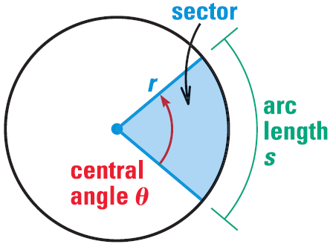
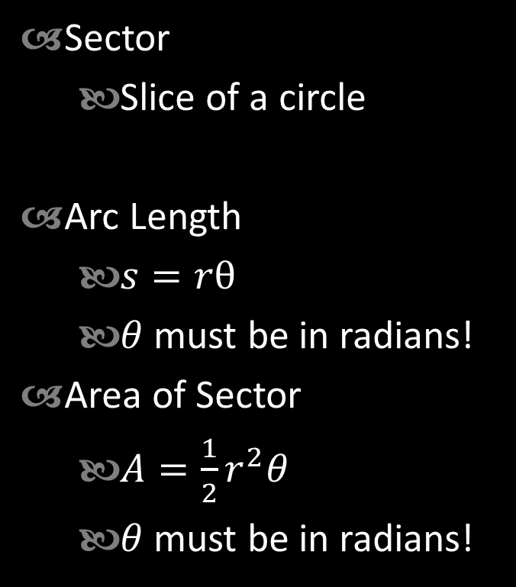
13.2 Define General Angles and Use Radian Measure
Sector
  Slice of a circle
Arc Length
  $s=rθ$
  $θ$ must be in radians!
Area of Sector
  $A=\frac{1}{2}r^{2}θ$
  $θ$ must be in radians!

Slide 20
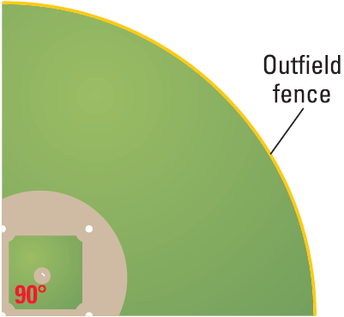

13.2 Define General Angles and Use Radian Measure
Find the length of the outfield fence if it is 220 ft from home plate.
$θ=\frac{π}{2}$
$s=rθ$
$s=220\left(\frac{π}{2}\right)$
$s=110π≈346 ft$
Find the area of the baseball field.
$A=\frac{1}{2}r^{2}θ$
$A=\frac{1}{2}{\left(220\right)}^{2}\left(\frac{π}{2}\right)$
$A=12100π≈38013ft^{2}$
Notes:
$$θ=\frac{π}{2}$$
$$s=rθ$$
$$s=220\left(\frac{π}{2}\right)=110π≈346$$
$$A=\frac{1}{2}r^{2}θ$$
$$A=\frac{1}{2}{\left(220\right)}^{2}\left(\frac{π}{2}\right)=12100π≈38013$$

Slide 21
Quiz
13.2 Homework Quiz

Slide 22
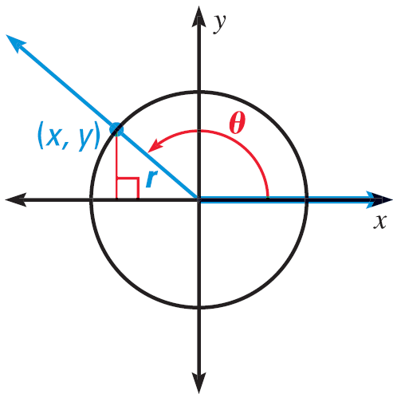
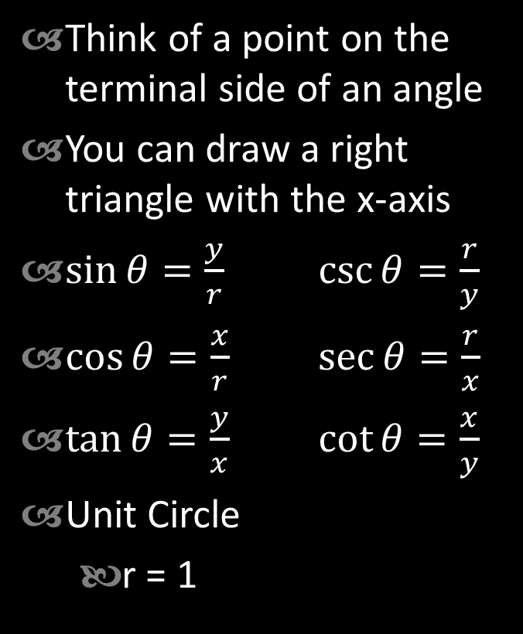
13.3 Evaluate Trigonometric Functions of Any Angle
Think of a point on the terminal side of an angle
You can draw a right triangle with the x-axis
$\sin{θ}=\frac{y}{r}$ $\csc{θ}=\frac{r}{y}$
$\cos{θ}=\frac{x}{r}$ $\sec{θ}=\frac{r}{x}$
$\tan{θ}=\frac{y}{x}$ $\cot{θ}=\frac{x}{y}$
Unit Circle
  r = 1

Slide 23
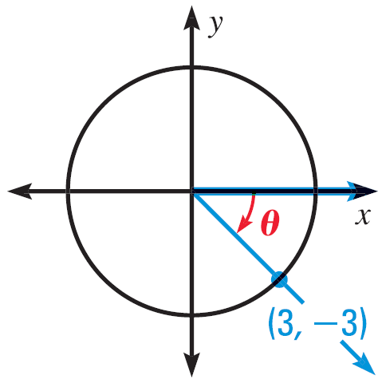
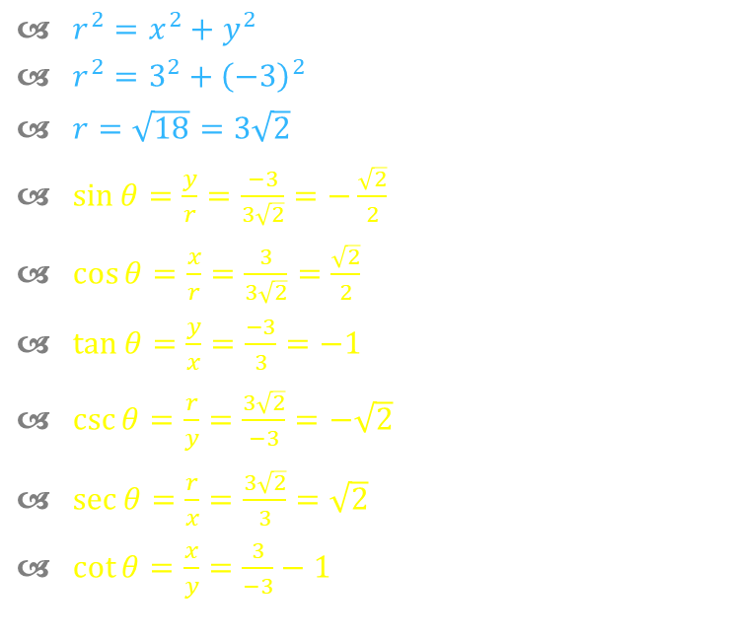
13.3 Evaluate Trigonometric Functions of Any Angle
Evaluate the six trigonometric functions of θ.
$r^{2}=x^{2}+y^{2}$
$r^{2}=3^{2}+{\left(−3\right)}^{2}$
$r=\sqrt{18}=3\sqrt{2}$
$\sin{θ}=\frac{y}{r}=\frac{−3}{3\sqrt{2}}=−\frac{\sqrt{2}}{2}$
$\cos{θ}=\frac{x}{r}=\frac{3}{3\sqrt{2}}=\frac{\sqrt{2}}{2}$
$\tan{θ}=\frac{y}{x}=\frac{−3}{3}=−1$
$\csc{θ}=\frac{r}{y}=\frac{3\sqrt{2}}{−3}=−\sqrt{2}$
$\sec{θ}=\frac{r}{x}=\frac{3\sqrt{2}}{3}=\sqrt{2}$
$\cot{θ}=\frac{x}{y}=\frac{3}{−3}−1$
Notes:
$$r^{2}=x^{2}+y^{2}=3^{2}+{\left(−3\right)}^{2}$$
$$r=\sqrt{18}=3\sqrt{2}$$
$\sin{θ}=−\frac{3}{3\sqrt{2}}=−\frac{\sqrt{2}}{2} \cos{θ}=\frac{3}{3\sqrt{2}}=\frac{\sqrt{2}}{2}$ $\tan{θ}=−\frac{3}{3}=−1$
$\csc{θ}=−\sqrt{2}$ $\sec{θ}=\sqrt{2}$ $\cot{θ}=−1$

Slide 24
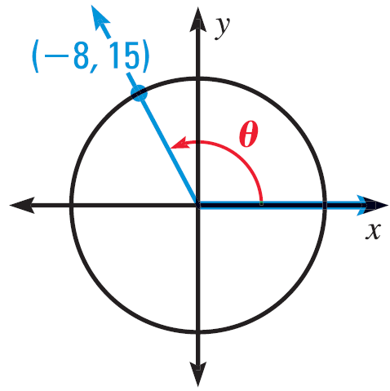
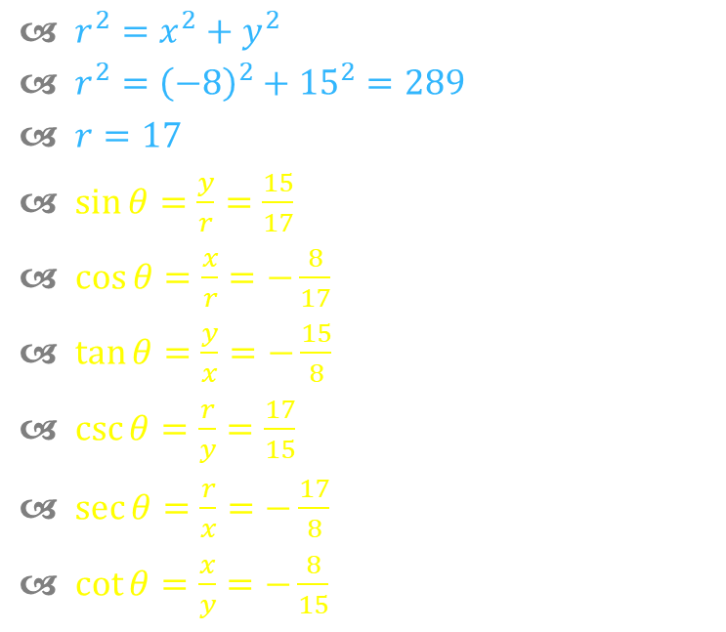
13.3 Evaluate Trigonometric Functions of Any Angle
Evaluate the six trigonometric functions of θ.
$r^{2}=x^{2}+y^{2}$
$r^{2}={\left(−8\right)}^{2}+{15}^{2}=289$
$r=17$
$\sin{θ}=\frac{y}{r}=\frac{15}{17}$
$\cos{θ}=\frac{x}{r}=−\frac{8}{17}$
$\tan{θ}=\frac{y}{x}=−\frac{15}{8}$
$\csc{θ}=\frac{r}{y}=\frac{17}{15}$
$\sec{θ}=\frac{r}{x}=−\frac{17}{8}$
$\cot{θ}=\frac{x}{y}=−\frac{8}{15}$
Notes:
$$r^{2}={\left(−8\right)}^{2}+{15}^{2}=289$$
$$r=17$$
$\sin{θ}=\frac{15}{17}$ $\cos{θ}=−\frac{8}{17}$ $\tan{θ}=−\frac{15}{8}$
$\csc{θ}=\frac{17}{15}$ $\sec{θ}=−\frac{17}{8}$ $\cot{θ}=−\frac{8}{15}$

Slide 25

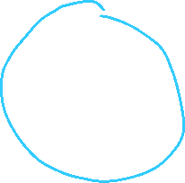
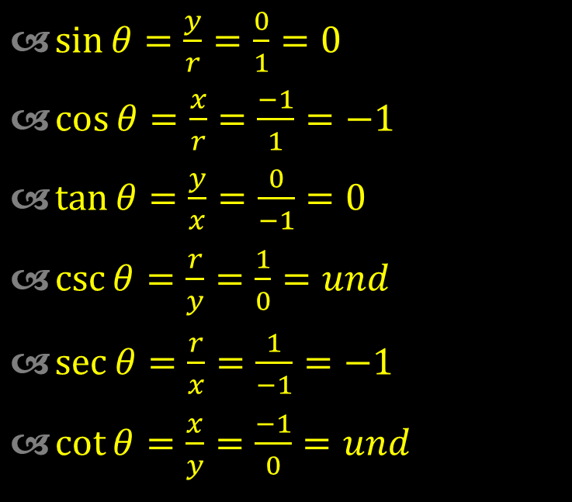
13.3 Evaluate Trigonometric Functions of Any Angle
Evaluate the six trigonometric functions of θ.
θ = 180°
$\sin{θ}=\frac{y}{r}=\frac{0}{1}=0$
$\cos{θ}=\frac{x}{r}=\frac{−1}{1}=−1$
$\tan{θ}=\frac{y}{x}=\frac{0}{−1}=0$
$\csc{θ}=\frac{r}{y}=\frac{1}{0}=und$
$\sec{θ}=\frac{r}{x}=\frac{1}{−1}=−1$
$\cot{θ}=\frac{x}{y}=\frac{−1}{0}=und$
Notes:
$\sin{θ}=0$ $\cos{θ}=−1$ $\tan{θ}=0$
$\csc{θ}=und$ $\sec{θ}=−1$ $\cot{θ}=und$

Slide 26
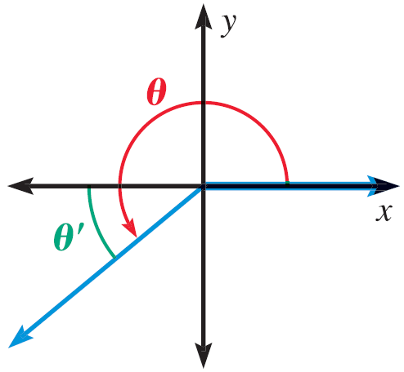
13.3 Evaluate Trigonometric Functions of Any Angle
Reference Angle
  Angle between terminal side and x-axis
  Has the same values for trig functions as 1st quadrant angles
  You just have to add the negative signs
Sin
All
Tan
Cos
Notes:
This gives what is positive.
The reciprocal functions are the same (csc is with sin, etc.)
Way to remember “All Students Take Calculus”

Slide 27

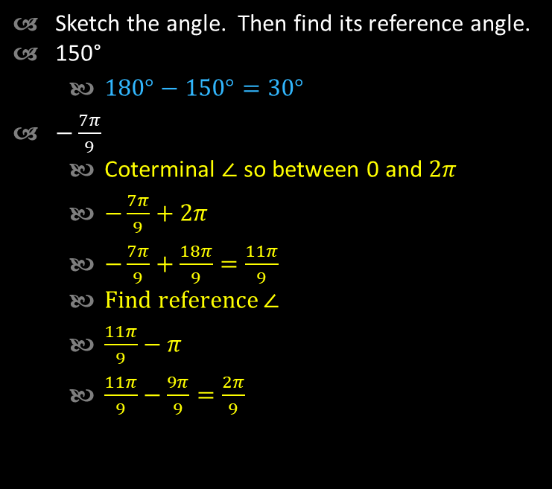


13.3 Evaluate Trigonometric Functions of Any Angle
Sketch the angle. Then find its reference angle.
150°
  $180°−150°=30°$
$−\frac{7π}{9}$
  Coterminal $∠$ so between 0 and $2π$
  $−\frac{7π}{9}+2π$
  $−\frac{7π}{9}+\frac{18π}{9}=\frac{11π}{9}$
  Find reference $∠$
  $\frac{11π}{9}−π$
  $\frac{11π}{9}−\frac{9π}{9}=\frac{2π}{9}$
Notes:
$$180°−150°=30°$$
$$π−\frac{7π}{9}=\frac{2π}{9}$$

Slide 28




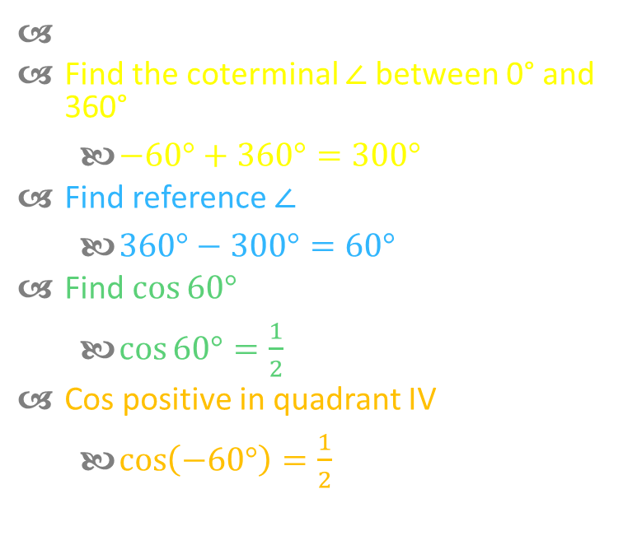

13.3 Evaluate Trigonometric Functions of Any Angle
Evaluate cos(-60°) without a calculator
Find the coterminal $∠$ between 0° and 360°
  $−60°+360°=300°$
Find reference $∠$
  $360°−300°=60°$
Find $\cos{60°}$
  $\cos{60°}=\frac{1}{2}$
Cos positive in quadrant IV
  $\cos\left(−60°\right)=\frac{1}{2}$
Notes:
Reference angle is 60°
In quadrant IV
$$\cos\left(−60°\right)=\frac{1}{2}$$

Slide 29

13.3 Evaluate Trigonometric Functions of Any Angle
Estimate the horizontal distance traveled by a Red Kangaroo who jumps at an angle of 8° and with an initial speed of 53 feet per second (35 mph).
Range Equation
$d=\frac{v^{2}}{32}\sin{2θ}$
$d=\frac{{53}^{2}}{32}\sin\left(2\left(8°\right)\right)=24.2 ft$
Notes:
$$d=\frac{v^{2}}{32}\sin{2θ}$$
$$d=\frac{{53}^{2}}{32}\sin\left(2\left(8°\right)\right)=24.2 ft$$

Slide 30
Quiz
13.3 Homework Quiz

Slide 31
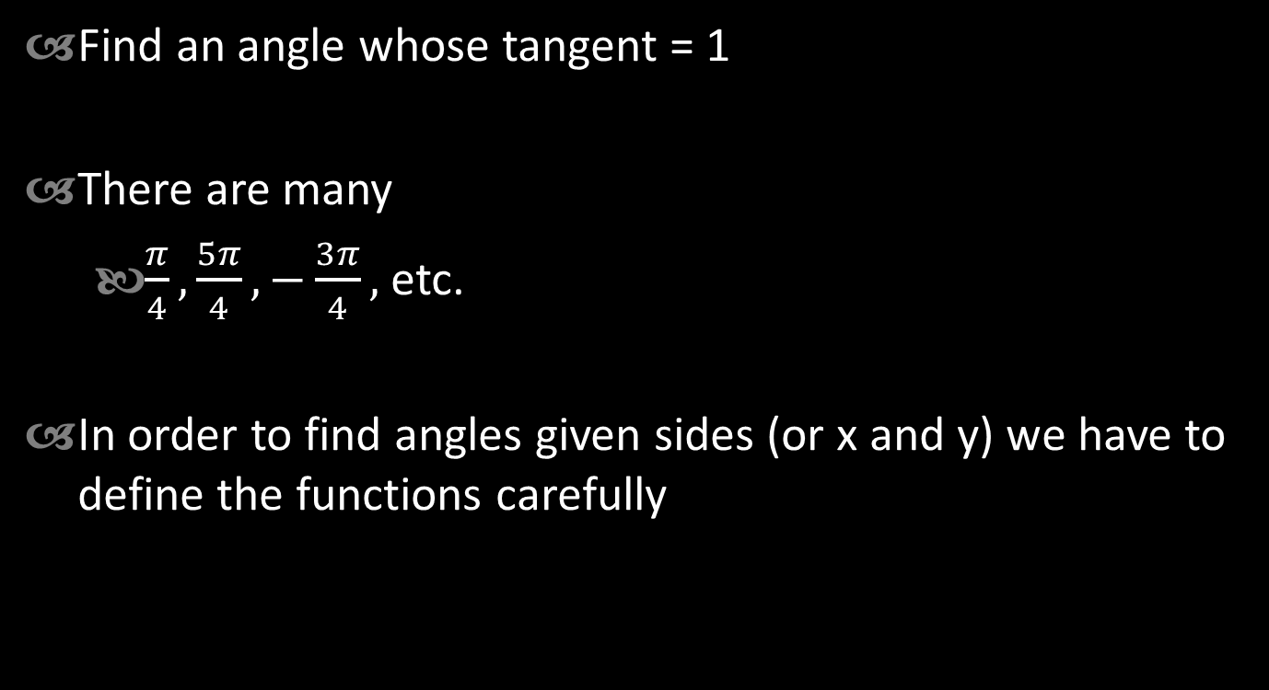
13.4 Evaluate Inverse Trigonometric Functions
Find an angle whose tangent = 1
There are many
  $\frac{π}{4},\frac{5π}{4}, −\frac{3π}{4},$etc.
In order to find angles given sides (or x and y) we have to define the functions carefully

Slide 32
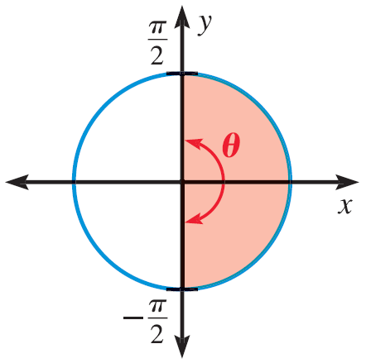
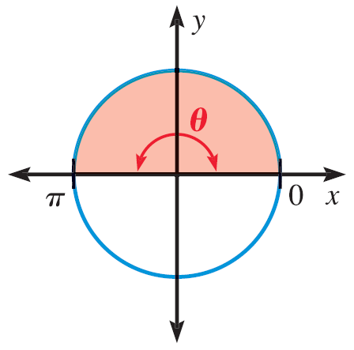

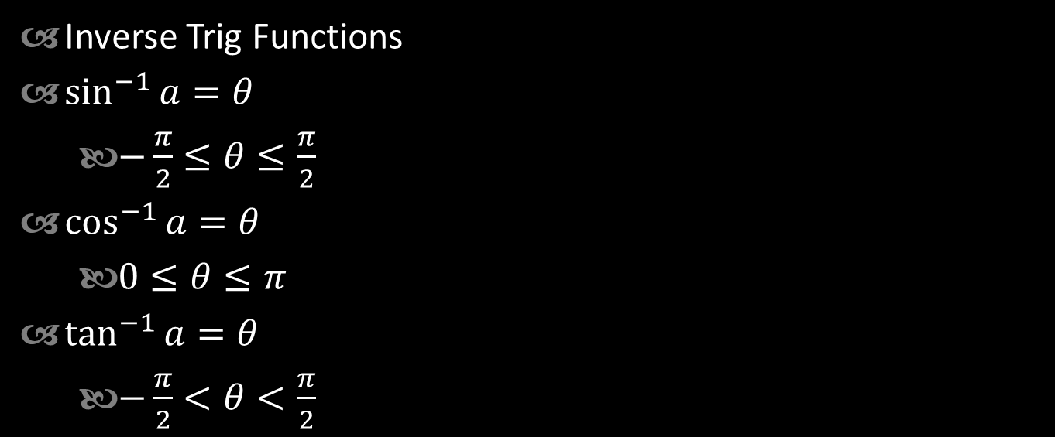


13.4 Evaluate Inverse Trigonometric Functions
$$\sin^{−1}{a}$$
Inverse Trig Functions
$\sin^{−1}{a}=θ$
  $−\frac{π}{2}≤θ≤\frac{π}{2}$
$\cos^{−1}{a}=θ$
  $0≤θ≤π$
$\tan^{−1}{a}=θ$
  $−\frac{π}{2}<θ<\frac{π}{2}$
$$\cos^{−1}{a}$$
$$\tan^{−1}{a}$$

Slide 33


13.4 Evaluate Inverse Trigonometric Functions
Evaluate the expression in both radians and degrees.
$\sin^{−1}{\frac{\sqrt{2}}{2}}$
  $\sin^{−1}{\frac{1}{\sqrt{2}}}$
  $=45° or\frac{π}{4}$
$\cos^{−1}{\frac{1}{2}}$
  $=60° or\frac{π}{3}$
$\tan^{−1}\left(−1\right)$
  $=−45° or −\frac{π}{4}$
Notes:
$$\sin^{−1}{\frac{\sqrt{2}}{2}}=45° \text{or} \frac{π}{4}$$
$$\cos^{−1}{\frac{1}{2}}=60° \text{or}\frac{π}{3}$$
$$\tan^{−1}{−1}=−45° \text{or} −\frac{π}{4}$$

Slide 34
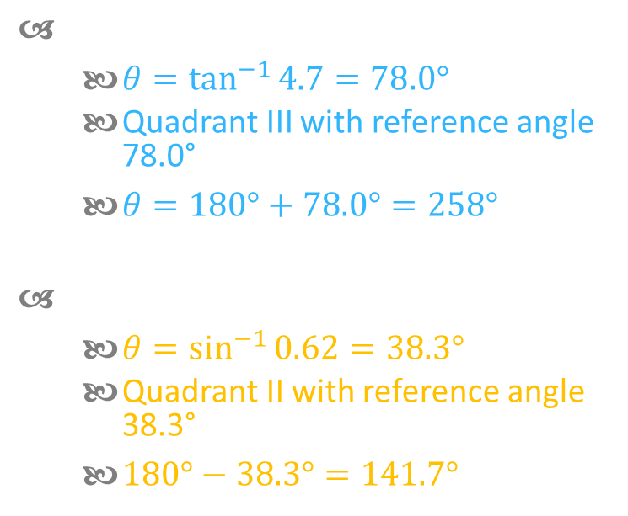
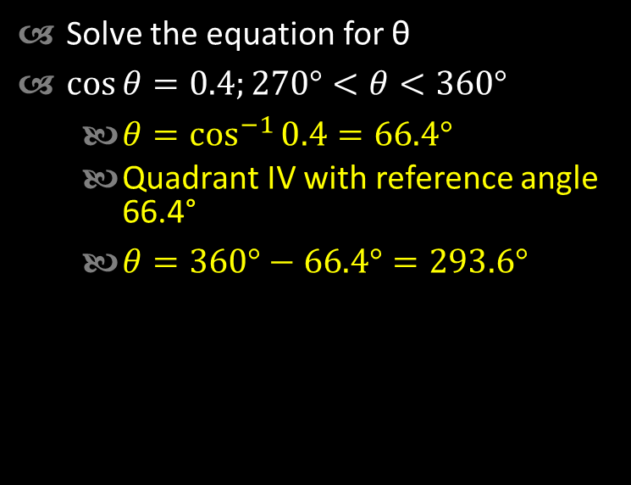



13.4 Evaluate Inverse Trigonometric Functions
Solve the equation for θ
$\cos{θ}=0.4;270°<θ<360°$
  $θ=\cos^{−1}{0.4}=66.4°$
  Quadrant IV with reference angle 66.4°
  $θ=360°−66.4°=293.6°$
$\tan{θ}=4.7;180°<θ<270°$
  $θ=\tan^{−1}{4.7}=78.0°$
  Quadrant III with reference angle 78.0°
  $θ=180°+78.0°=258°$
$\sin{θ}=0.62;90°<θ<180°$
  $θ=\sin^{−1}{0.62}=38.3°$
  Quadrant II with reference angle 38.3°
  $180°−38.3°=141.7°$
Notes:
$$\cos{θ}=0.4$$
$$θ=\cos^{−1}{0.4}=66.4°$$
Quadrant IV with reference angle 66.4°
$$θ=360°−66.4°=293.6°$$
$$\tan{θ}=4.7$$
$$θ=\tan^{−1}{4.7}=78.0°$$
Quadrant III with reference angle 78.0°
$$180°+78.0°=258°$$
$$\sin{θ}=0.62$$
$$θ=\sin^{−1}{0.62}=38.3°$$
Quadrant II with reference angle 38.3°
$$180°−38.3°=141.7°$$

Slide 35
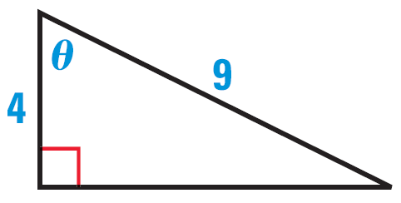

13.4 Evaluate Inverse Trigonometric Functions
Find the measure of angle θ.
$\cos{θ}=\frac{4}{9}$
$θ=\cos^{−1}{\frac{4}{9}}=63.6°$
Notes:
$$\cos{θ}=\frac{4}{9}$$
$$θ=\cos^{−1}{\frac{4}{9}}=63.6°$$

Slide 36


13.4 Evaluate Inverse Trigonometric Functions
Find the measure of angle θ.
$\tan{θ}=\frac{10}{8}$
$θ=\tan^{−1}{\frac{10}{8}}=51.3°$
Notes:
$$\tan{θ}=\frac{10}{8}$$
$$θ=\tan^{−1}{\frac{10}{8}}=51.3°$$

Slide 37
Quiz
13.4 Homework Quiz

Slide 38


13.5 Apply the Law of Sines
In lesson 13.1 we solved right triangles
In this lesson we will solve any triangle if we know
  2 Angles and 1 Side (AAS or ASA)
  2 Sides and 1 Angle opposite a side (SSA)
Law of Sines
  $\frac{\sin{A}}{a}=\frac{\sin{B}}{b}=\frac{\sin{C}}{c}$

Slide 39


13.5 Apply the Law of Sines
Solve ΔABC if…
  A = 51°, B = 44°, c = 11
$C=180°−51°−44°=85°$
$\frac{\sin{C}}{c}=\frac{\sin{A}}{a}$
$\frac{\sin{85°}}{11}=\frac{\sin{51°}}{a}$
$a⋅\sin{85°}=11⋅\sin{51°}$
$a=\frac{11⋅\sin{51°}}{\sin{85°}}≈8.58$
$\frac{\sin{C}}{c}=\frac{\sin{B}}{b}$
$\frac{\sin{85°}}{11}=\frac{\sin{44°}}{b}$
$b⋅\sin{85°}=11⋅\sin{44°}$
$b=\frac{11⋅\sin{44°}}{\sin{85°}}≈7.67$
Notes:
$$C=180°−51°−44°=85°$$
$$\frac{\sin{C}}{c}=\frac{\sin{A}}{a}$$
$$\frac{\sin{85°}}{11}=\frac{\sin{51°}}{a}$$
$$a⋅\sin{85°}=11⋅\sin{51°}$$
$$a=\frac{11⋅\sin{51°}}{\sin{85°}}≈8.58$$
$$\frac{\sin{C}}{c}=\frac{\sin{B}}{b}$$
$$\frac{\sin{85°}}{11}=\frac{\sin{44°}}{b}$$
$$b⋅\sin{85°}=11⋅\sin{44°}$$
$$b=\frac{11⋅\sin{44°}}{\sin{85°}}≈7.67$$

Slide 40


13.5 Apply the Law of Sines
Indeterminant Case (SSA)
  Maybe no triangle, one triangle, or two triangles
In these examples, you know a, b, A
If A > 90° and…
  a ≤ b → no triangle
  a > b → 1 triangle

Slide 41


13.5 Apply the Law of Sines
A < 90° and… (h = b sin A)
  h > a → no triangle
  h = a → one triangle

Slide 42


13.5 Apply the Law of Sines
    a ≥ b → one triangle
    h < a < b → two triangles

Slide 43




13.5 Apply the Law of Sines
$C=180°−34.4°−122°=23.6°$
$\frac{\sin{A}}{a}=\frac{\sin{C}}{c}$
$\frac{\sin{122°}}{18}=\frac{\sin{23.6°}}{c}$
$c⋅\sin{122°}=18\sin{23.6°}$
$c=\frac{18\sin{23.6°}}{\sin{122°}}≈8.50$
Solve ΔABC
  A = 122°, a = 18, b = 12
$A>90°$ and $a>b$ → one triangle
$\frac{\sin{A}}{a}=\frac{\sin{B}}{b}$
$\frac{\sin{122°}}{18}=\frac{\sin{B}}{12}$
$18\sin{B}=12\sin{122°}$
$\sin{B}=\frac{12\sin{122°}}{18}≈0.5654$
$B=\sin^{−1}{0.5654}≈34.4°$
Notes:
a > b → one triangle
$$\frac{\sin{A}}{a}=\frac{\sin{B}}{b}$$
$$\frac{\sin{122°}}{18}=\frac{\sin{B}}{12}$$
$$18\sin{B}=12\sin{122°}$$
$$\sin{B}=\frac{12\sin{122°}}{18}≈0.5654$$
$$B=\sin^{−1}{0.5654}≈34.4°$$
$$C=180°−34.4°−122°=23.6°$$
$$\frac{\sin{A}}{a}=\frac{\sin{C}}{c}$$
$$\frac{\sin{122°}}{18}=\frac{\sin{23.6°}}{c}$$
$$c⋅\sin{122°}=18\sin{23.6°}$$
$$c=\frac{18\sin{23.6°}}{\sin{122°}}≈8.50$$

Slide 44




13.5 Apply the Law of Sines
Solve ΔABC
  A = 36°, a = 9, b = 12
$h=b\sin{A}=12\sin{36}°=7.05;$
$h < a < b$ → two solutions
First solution
$\frac{\sin{A}}{a}=\frac{\sin{B}}{b}$
$\frac{\sin{36°}}{9}=\frac{\sin{B}}{12}$
$9\sin{B}=12\sin{36°}$
$\sin{B}=\frac{12\sin{36°}}{9}≈0.7837$
$B=\sin^{−1}{0.7837}≈51.6°$
$C=180°−51.6°−36°=92.4°$
$\frac{\sin{A}}{a}=\frac{\sin{C}}{c}$
$\frac{\sin{36°}}{9}=\frac{\sin{92.4°}}{c}$
$c\sin{36°}=9\sin{92.4°}$
$c=\frac{9\sin{92.4°}}{\sin{36°}}≈15.3$
Notes:
h = b sin A = 12 sin 36° = 7.05; h < a < b → two solutions
$$\frac{\sin{A}}{a}=\frac{\sin{B}}{b}$$
$$\frac{\sin{36°}}{9}=\frac{\sin{B}}{12}$$
$$9\sin{B}=12\sin{36°}$$
$$\sin{B}=\frac{12\sin{36°}}{9}≈0.7837$$
$$B=\sin^{−1}{0.7837}≈51.6°$$
To angles for B and they are supplementary
$B=51.6°$ $B^{′}=180°−51.6°=128.4°$
$C=180°−51.6°−36°=92.4°$ $C^{′}=180°−128.4°−36°=15.6°$
$$\frac{\sin{A}}{a}=\frac{\sin{C}}{c}$$
$\frac{\sin{36°}}{9}=\frac{\sin{92.4°}}{c}$ $\frac{\sin{36°}}{9}=\frac{\sin{15.6°}}{c}$
$c\sin{36°}=9\sin{92.4°}$ $c\sin{36°}=9\sin{15.6°}$
$c=\frac{9\sin{92.4°}}{\sin{36°}}≈15.3$ $c=\frac{9\sin{15.6°}}{\sin{36°}}≈4.1$

Slide 45



13.5 Apply the Law of Sines
Solve ΔABC
  A = 36°, a = 9, b = 12
Second solution
To angles for B and they are supplementary
$B^{′}=180°−B$
$B^{′}=180°−51.6°=128.4°$
$C^{′}=180°−128.4°−36°=15.6°$
$\frac{\sin{A}}{a}=\frac{\sin{C′}}{c′}$
$\frac{\sin{36°}}{9}=\frac{\sin{15.6°}}{c′}$
$c′\sin{36°}=9\sin{15.6°}$
$c′=\frac{9\sin{15.6°}}{\sin{36°}}≈4.1$
Notes:
h = b sin A = 12 sin 36° = 7.05; h < a < b → two solutions
$$\frac{\sin{A}}{a}=\frac{\sin{B}}{b}$$
$$\frac{\sin{36°}}{9}=\frac{\sin{B}}{12}$$
$$9\sin{B}=12\sin{36°}$$
$$\sin{B}=\frac{12\sin{36°}}{9}≈0.7837$$
$$B=\sin^{−1}{0.7837}≈51.6°$$
To angles for B and they are supplementary
$B=51.6°$ $B^{′}=180°−51.6°=128.4°$
$C=180°−51.6°−36°=92.4°$ $C^{′}=180°−128.4°−36°=15.6°$
$$\frac{\sin{A}}{a}=\frac{\sin{C}}{c}$$
$\frac{\sin{36°}}{9}=\frac{\sin{92.4°}}{c}$ $\frac{\sin{36°}}{9}=\frac{\sin{15.6°}}{c}$
$c\sin{36°}=9\sin{92.4°}$ $c\sin{36°}=9\sin{15.6°}$
$c=\frac{9\sin{92.4°}}{\sin{36°}}≈15.3$ $c=\frac{9\sin{15.6°}}{\sin{36°}}≈4.1$

Slide 46





13.5 Apply the Law of Sines
Area of Triangle
  $Area=\frac{1}{2}bh$
  $h=c\sin{A}$
  $Area=\frac{1}{2}bc\sin{A}$
Find the area of ΔABC with…
  a = 10, b = 14, C = 46°
$Area=\frac{1}{2}ab\sin{C}$
$Area=\frac{1}{2}\left(10\right)\left(14\right)\sin{46°}≈50.4$
Notes:
$$Area=\frac{1}{2}ab\sin{C}$$
$$Area=\frac{1}{2}\left(10\right)\left(14\right)\sin{46°}≈50.4$$

Slide 47
Quiz
13.5 Homework Quiz

Slide 48


13.6 Apply the Law of Cosines
When you need to solve a triangle and can’t use Law of Sines, use Law of Cosines
  2 Sides and Included angle (SAS)
  3 Sides (SSS)
Law of Cosines
  $a^{2}=b^{2}+c^{2}−2bc\cos{A}$
  $b^{2}=a^{2}+c^{2}−2ac\cos{B}$
  $c^{2}=a^{2}+b^{2}−2ab\cos{C}$
Notes:
You can use the Law of Cosines, then Law of Sines as long as you don’t create the SSA case.

Slide 49




13.6 Apply the Law of Cosines
Solve ΔABC if…
  a = 8, c = 10, B = 48°
$b^{2}=a^{2}+c^{2}−2ac\cos{B}$
$b^{2}=8^{2}+{10}^{2}−2\left(8\right)\left(10\right)\cos{48°}$
$b^{2}=56.94$
$b=7.55$
$a^{2}=b^{2}+c^{2}−2ab\cos{A}$
$8^{2}={7.55}^{2}+{10}^{2}−2\left(7.55\right)(10)\cos{A}$
$64=57.00+100−151\cos{A}$
$−93=−151\cos{A}$
$0.6159=\cos{A}$
$A=\cos^{−1}{0.6159}≈52.0°$
$C=180°−48°−52.0°=80°$
Notes:
$$b^{2}=a^{2}+c^{2}−2ac\cos{B}$$
$$b^{2}=8^{2}+{10}^{2}−2\left(8\right)\left(10\right)\cos{48°}=56.94$$
$$b=7.55$$
$$a^{2}=b^{2}+c^{2}−2ab\cos{A}$$
$$8^{2}={7.55}^{2}+{10}^{2}−2⋅7.55⋅10\cos{A}$$
$$64=57.00+100−151\cos{A}$$
$$−93=−151\cos{A}$$
$$0.61589404=\cos{A}$$
$$A=\cos^{−1}{0.61589404}≈52.0°$$
$$C=180°−48°−52.0°=80°$$

Slide 50




13.6 Apply the Law of Cosines
Solve ΔABC if…
  a = 14, b = 16, c = 9
$a^{2}=b^{2}+c^{2}−2bc\cos{A}$
${14}^{2}={16}^{2}+9^{2}−2\left(16\right)\left(9\right)\cos{A}$
$196=256+81−288\cos{A}$
$−141=−288\cos{A}$
$0.4896=\cos{A}$
$A=\cos^{−1}{0.4896}≈60.7°$
$b^{2}=a^{2}+c^{2}−2ac\cos{B}$
${16}^{2}={14}^{2}+9^{2}−2\left(14\right)\left(9\right)\cos{B}$
$256=196+81−252\cos{B}$
$−21=−252\cos{B}$
$0.0833=\cos{B}$
$B=\cos^{1}{0.0833}≈85.2°$
$C=180°−60.7°−85.2°=34.1°$
Notes:
$$a^{2}=b^{2}+c^{2}−2bc\cos{A}$$
$${14}^{2}={16}^{2}+9^{2}−2\left(16\right)\left(9\right)\cos{A}$$
$$196=256+81−288\cos{A}$$
$$−141=−288\cos{A}$$
$$0.4896=\cos{A}$$
$$A=\cos^{−1}{0.4896}≈60.7°$$
$$b^{2}=a^{2}+c^{2}−2ac\cos{B}$$
$${16}^{2}={14}^{2}+9^{2}−2⋅14⋅9\cos{B}$$
$$256=196+81−252\cos{B}$$
$$−21=−252\cos{B}$$
$$0.08333333333=\cos{B}$$
$$B=\cos^{1}{0.0833333}≈85.2°$$
$$C=180°−60.7°−85.2°=34.1°$$

Slide 51


13.6 Apply the Law of Cosines
Heron’s Area Formula
  $Area=\sqrt{s\left(s−a\right)\left(s−b\right)\left(s−c\right)}$
    Where $s=\frac{1}{2}\left(a+b+c\right)$
Find the area of ΔABC
$s=\frac{1}{2}\left(a+b+c\right)$
$s=\frac{1}{2}\left(8+11+5\right)=12$
$Area=\sqrt{s\left(s−a\right)\left(s−b\right)\left(s−c\right)}$
$Area=\sqrt{12\left(12−8\right)\left(12−11\right)\left(12−5\right)}=\sqrt{336}=18.3$
Notes:
$$s=\frac{1}{2}\left(a+b+c\right)$$
$$s=\frac{1}{2}\left(8+11+5\right)=12$$
$$Area=\sqrt{s\left(s−a\right)\left(s−b\right)\left(s−c\right)}$$
$$Area=\sqrt{12\left(12−8\right)\left(12−11\right)\left(12−5\right)}=\sqrt{336}=18.3$$

Slide 52
Quiz
13.6 Homework Quiz

